Slide 1
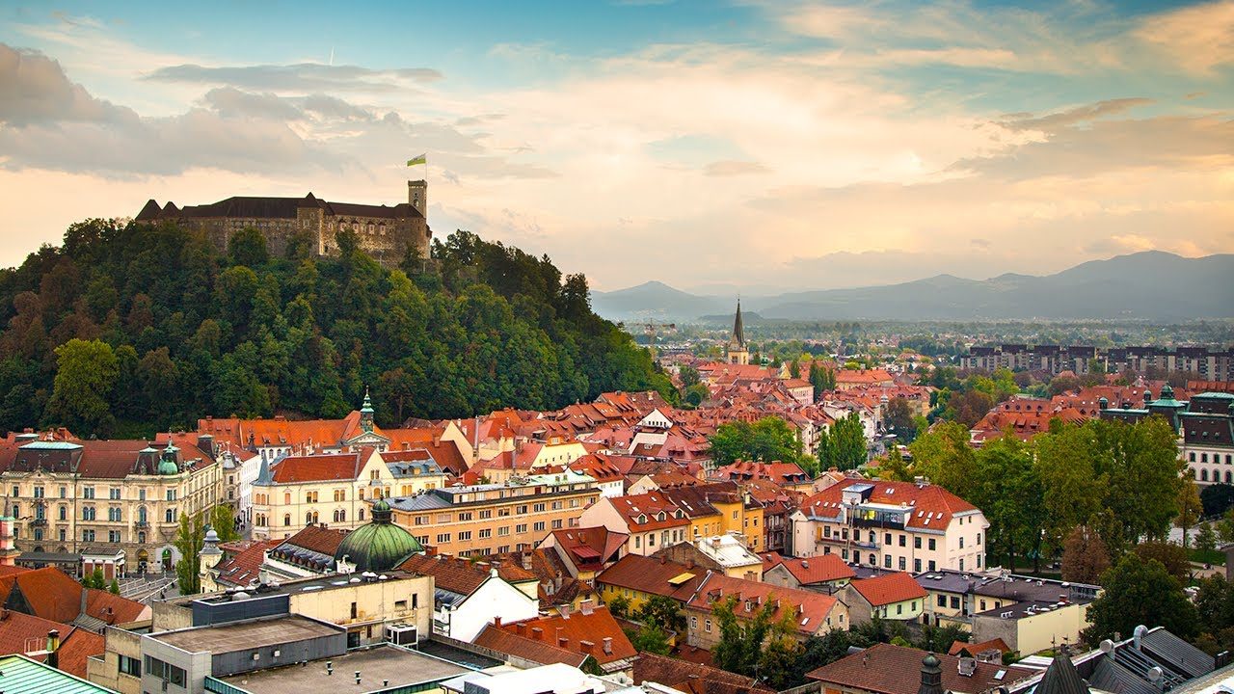
LJUBLJANA

Slide 2
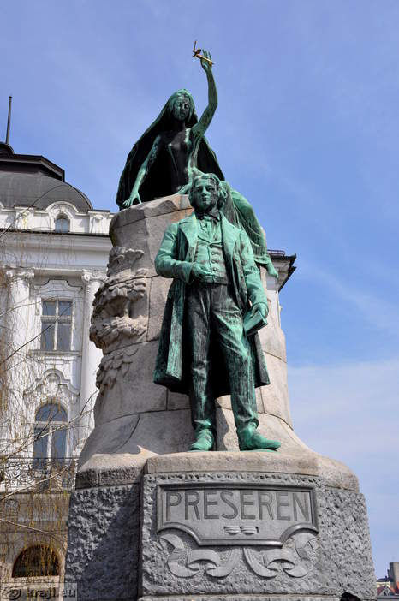
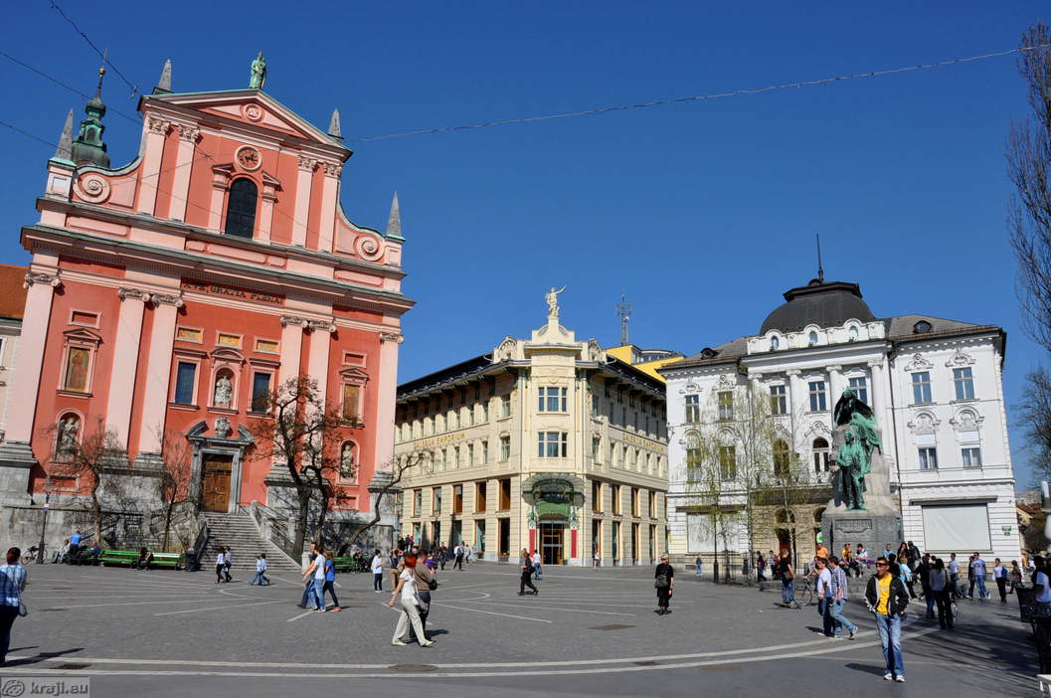
FRANCISCAN CHURCH
PHARMACY
DEPARTMENT STORE
PREŠEREN SQUARE
PREŠEREN STATUE

Slide 3
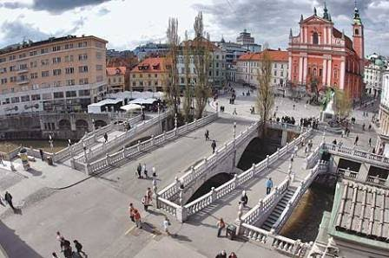
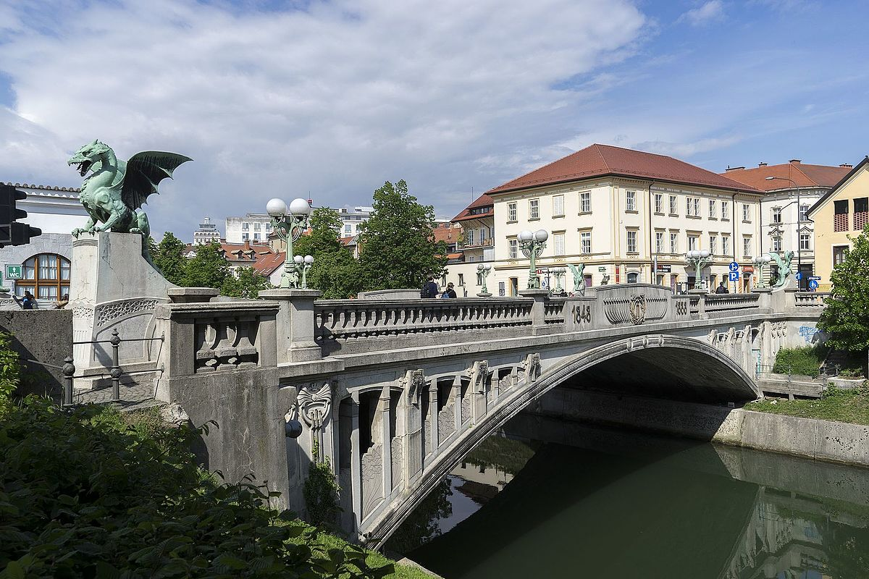
TRIPLE BRIDGE
DRAGON BRIDGE

Slide 4
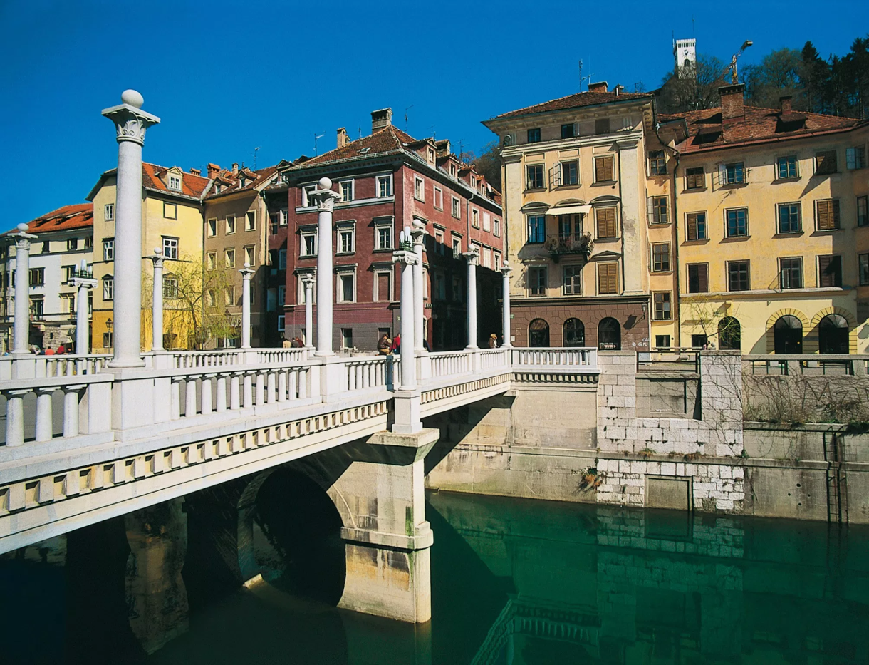
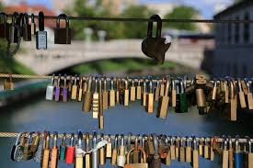
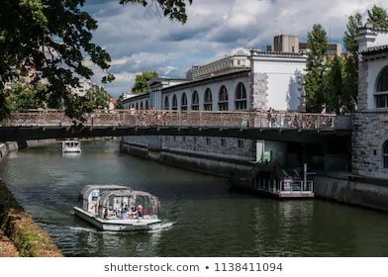
COBBLERS‘ BRIDGE
BUTCHER‘S BRIDGE or LJUBLJANA‘S LOVE BRIDGE

Slide 5
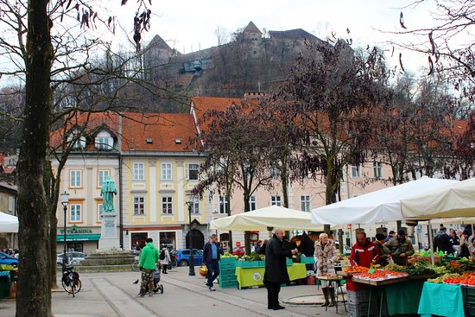
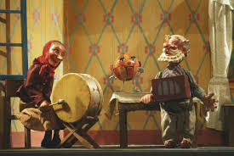
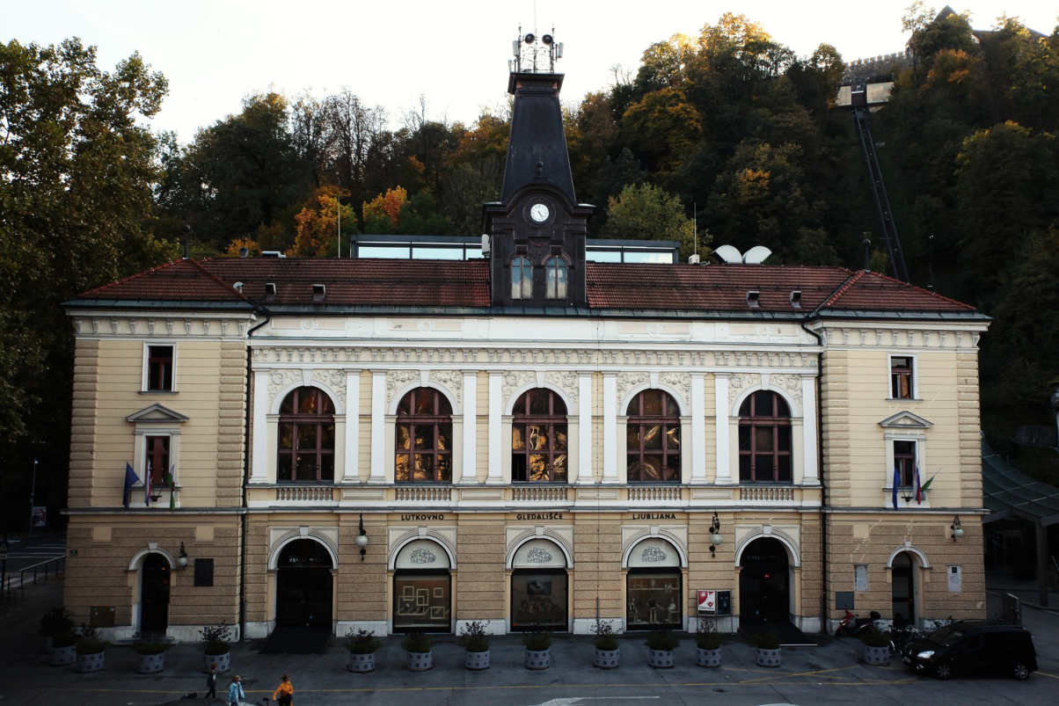
LJUBLJANA‘S MARKET
ŠENTJAKOB THEATRE or PUPPET THEATRE

Slide 6
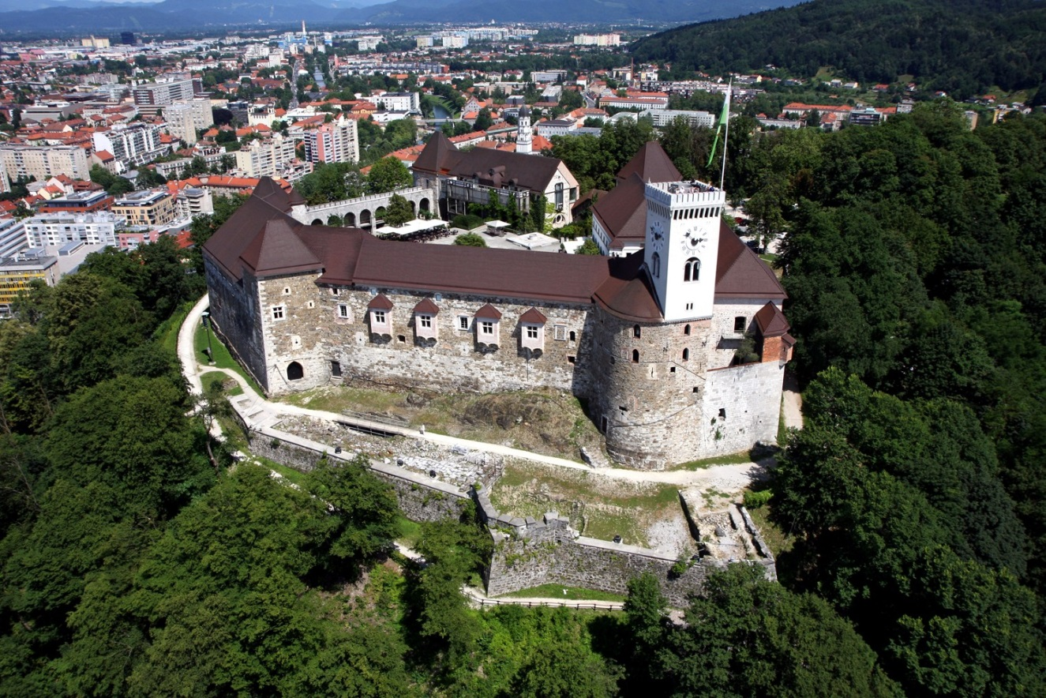
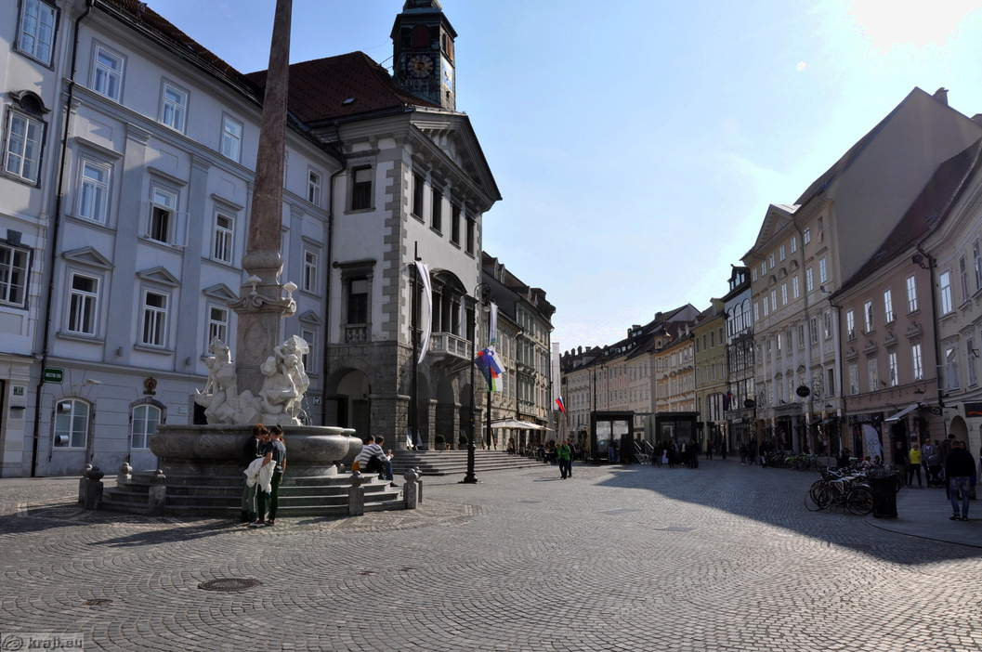
LJUBLJANA CASTLE
TOWN HALL
TOWN SQUARE with
Robba‘s Fountain

Slide 7
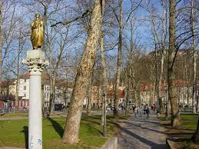
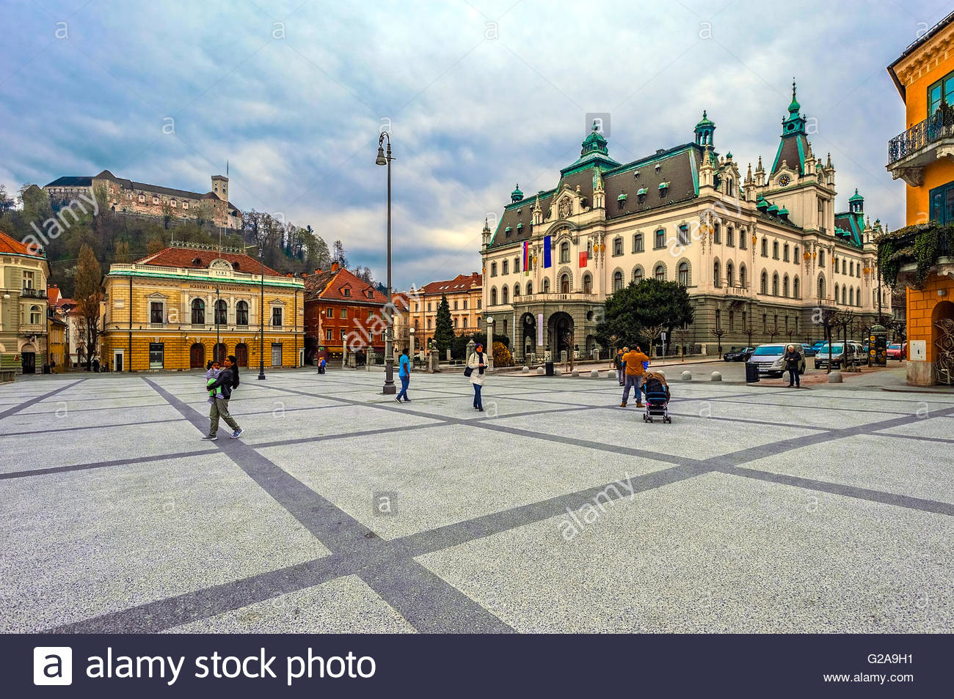
THE SLOVENIAN PHILHARMONIC BUILDING
THE UNIVERSITY
ZVEZDA PARK
CONGRESS SQUARE

Slide 8
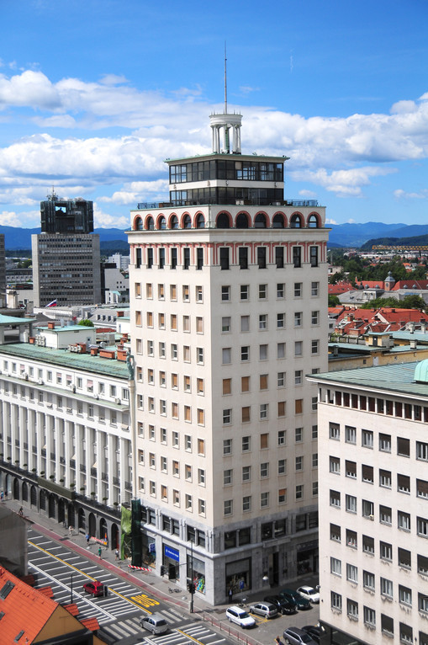
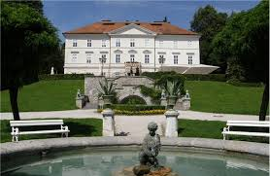
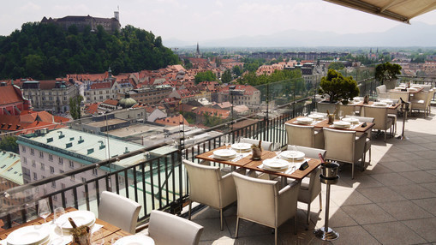
SKYSCRAPER
TIVOLI PARK
CAFÉ Nebotičnik

